Slide 1
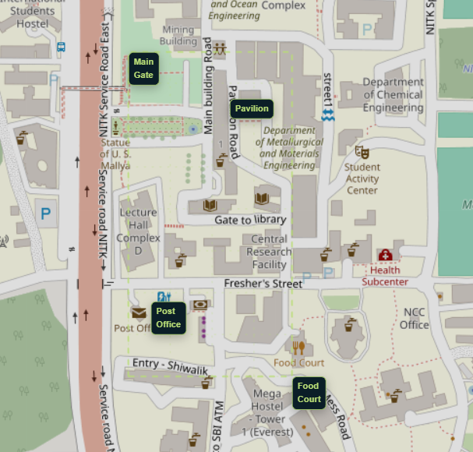
TECH TITANS • SMART CAMPUS
Smart Pollution Monitoring
NITK CAMPUS
N02
N01
Real-time spatial sensing, anomaly detection & prediction for NITK
IoT
SPATIAL INTELLIGENCE
MACHINE LEARNING
N03
Sense → Locate → Understand → Predict → Act
Interactive spatial map
Time-aware monitoring + local trends + ML forecast
SMART CAMPUS ENVIRONMENTAL INTELLIGENCE • NITK
01

Slide 2
01 • THE CHALLENGE
Campus conditions change by place and by time
A useful environmental system must see the difference between locations, not only report a single campus value.
01
Spatial blind spots
02
Reactive monitoring
03
Missing context
A single reading cannot reveal where conditions are elevated inside a campus.
Current or historical values show what happened; they do not anticipate what happens next.
A high value needs comparison with local behaviour and surrounding locations to become meaningful.
The key question
WHERE is the condition changing, WHY might it be happening, and WHAT happens next?
SMART CAMPUS ENVIRONMENTAL INTELLIGENCE • NITK
02

Slide 3
02 • OUR SYSTEM
From low-cost sensing to environmental intelligence
The architecture is modular: the sensing layer can grow without changing the intelligence and dashboard layers.
01
02
03
04
05
06
SENSE
COLLECT
ANALYZE
PREDICT
VISUALIZE
ACT
ESP32 + DHT11 + KY-038 / LM393
Timestamp + Node identity
Spatial + temporal comparison
LSTM-based forecasting
Interactive NITK map + trends
Hotspot / alert / response
Current prototype
ESP32 nodes → real sensor data → interactive dashboard
ML LAYER IN DEVELOPMENT
SMART CAMPUS ENVIRONMENTAL INTELLIGENCE • NITK
03

Slide 4
03 • PROTOTYPE
We are building the system, not just proposing it
The current proof of concept uses real ESP32 sensor readings and a live geographic interface.
CURRENT HARDWARE
CURRENT MONITORING NODES
ESP32
N01
LHC D
Noise
Node controller + communication
DHT11
N02
Main Building
Temperature + Humidity + Noise
Temperature + humidity
KY-038 / LM393
N03
Main Gate
Temperature + Humidity + Noise
Relative acoustic signal
REAL SENSOR DATA
The Main Building temperature/humidity stream is now feeding the data pipeline.
SMART CAMPUS ENVIRONMENTAL INTELLIGENCE • NITK
04

Slide 5
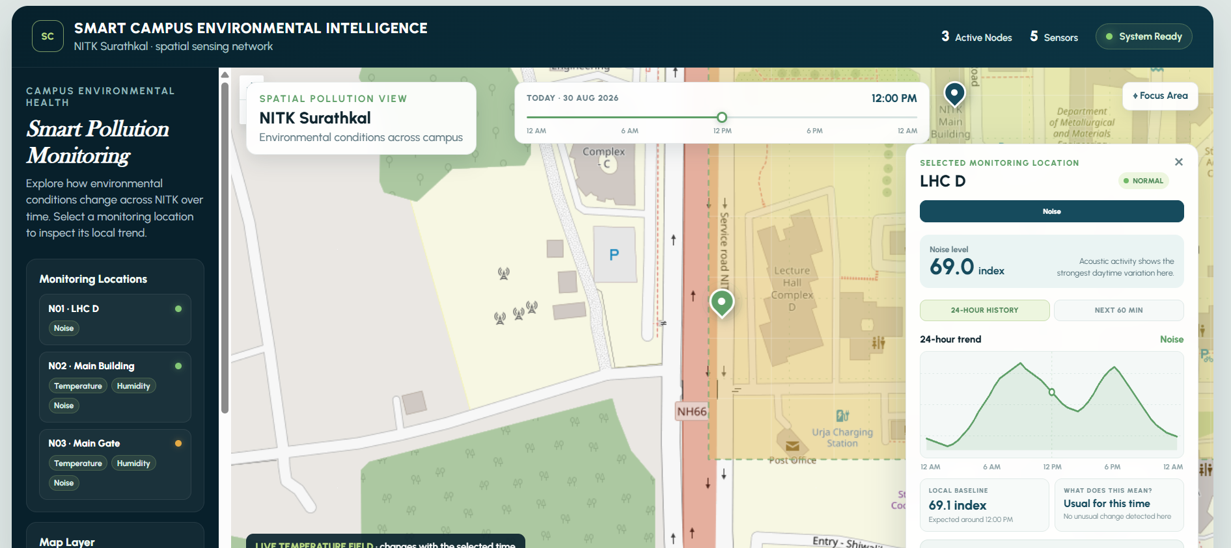
04 • DASHBOARD
The campus becomes the interface
The dashboard turns raw readings into a spatial and temporal view that a user can explore in seconds.
1
Interactive map
Click a node and move directly to its location.
2
2
Time navigation
Replay the day with a single timeline.
3
Parameter trends
Noise, temperature or humidity — selected by the user.
1
3
4
Future trends
The same panel will show the ML forecast.
8 AM
12 PM
6 PM
SMART CAMPUS ENVIRONMENTAL INTELLIGENCE • NITK
05

Slide 6
05 • INNOVATION
Three ideas make the network intelligent
The differentiator is not the sensor itself — it is how the system interprets location, time and change.
01
Location-aware baseline
02
Explainable hotspot detection
03
Predictive monitoring
What is normal here? Compare each reading with the behaviour expected at that location and time.
Why was it flagged? Combine local deviation, neighbouring nodes and sustained trends before raising attention.
What happens next? Use the temporal sequence to forecast near-future temperature and support early action.
The result: current state → unusual behaviour → future trend
SMART CAMPUS ENVIRONMENTAL INTELLIGENCE • NITK
06

Slide 7
06 • ML INTEGRATION
From real sensor history to future temperature
The forecasting layer is being developed separately and will plug into the dashboard through a clean prediction output.
LSTM FORECASTING PIPELINE
ACTUAL → PREDICTED
Real sensor data
temperature + humidity
Preprocessing
time ordering + resampling
Sequence
previous time window
LSTM
learn temporal pattern
Forecast
next 15 / 30 / 60 min
REAL
LSTM
Evaluation metric: MAE (°C)
Today: pipeline + interface Next: retrain with longer continuous recordings
SMART CAMPUS ENVIRONMENTAL INTELLIGENCE • NITK
07

Slide 8
07 • PROGRESSION & FUTURE
From prototype → deployable campus intelligence
Every future capability extends the same core architecture rather than replacing it.
NOW
DONE / LIVE
READY
IN DEV
NEXT
SCALE
Hardware prototype
Real data
Dashboard
ML
Intelligence
Campus
ESP32 + DHT11 + KY-038
Initial Main Building recordings
Interactive NITK map + time + trends
LSTM temperature forecasting
Hotspots + local baselines + explainability
More nodes + calibrated air-quality sensing
FUTURE VISION
A low-cost environmental intelligence layer that learns where conditions change, predicts what comes next, and helps the campus respond early.
Detect • Locate • Understand • Predict • Act
Current prototype scope: temperature, humidity and relative acoustic sensing; future air-quality sensing is modular.
SMART CAMPUS ENVIRONMENTAL INTELLIGENCE • NITK
08

